Slide 1

Advanced Programming
(C Programming language)
Chapter3– Math Functions and Character File Input/Output

Slide 2
3.1 Math Library Functions
Most of the C compilers support these basic math functions.
Function | Meaning | Function | Meaning
sqrt(x) | Square root of x, x >= 0 | exp(x) | e to the x power
fabs(x) | Absolute value of x | pow(x,y) | x to the power y
log(x) | Natural log of x, x > 0 | sin(x) | Sine of x
log10(x) | Base 10 log of x, x > 0 | cos(x) | Cosine of x

Slide 3
Mathematical Functions
There are more than twenty mathematical functions declared in <math.h>; here are some of the more frequently used.
Each takes one or two double arguments and returns a double.
sin(x) sine of x, x in radians
cos(x) cosine of x, x in radians
atan2(y,x) arctangent of y/x, in radians
exp(x) exponential function ex
log(x) natural (base e) logarithm of x (x>0)
log10(x) common (base 10) logarithm of x (x>0)
pow(x,y) x^{y}
sqrt(x) square root of x (x>0)
fabs(x) absolute value of x

Slide 4
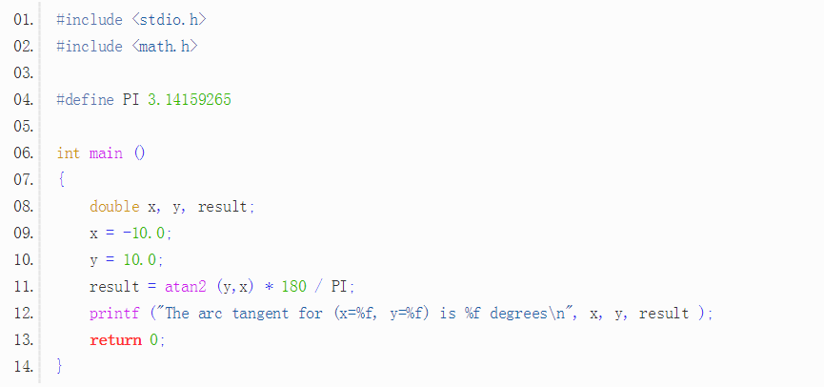

Slide 5
3.2 Single Character Data
Standard Input and Output
int getchar(void)
The symbolic constant EOF is defined in <stdio.h>. The value is typically -1
int putchar(int)
is used for output: putchar(c) puts the character c on the standard output, which is by default the screen. putchar returns the character written

Slide 6
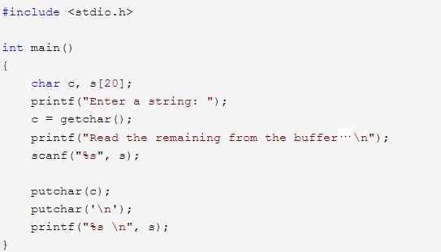

Slide 7
CHARACTER VARIABLES
1.Storage form
store character’s ASCII value
char ch1, ch2;
/*declare two character variables：ch1，ch2*/
ch1=’a’; /*assignment*/
ch2=’b’; /*assignment*/

Slide 8
speciality
characters and integers can be stored as the same forms,so
characters and integers are currency in C
e.g. ch1=‘a’ viz. 97
(1)Two kinds output forms of characters
Output form with character variable
and output form with integer
0 1 1 0 0 0 0 1

Slide 9
main() {
char ch1,ch2;
ch1='a';
ch2='b';
printf(“ch1=%c,ch2=%c\n”,ch1,ch2);
printf(“ch1=%d,ch2=%d\n”,ch1,ch2);
}
result：
ch1=a,ch2=b
ch1=97,ch2=98

Slide 10
Characters are allowed to participate in numeric operations just as any other integers,
viz.its ASCII value participate in numeric operations.
main()
{ char ch1,ch2;
ch1=‘a’; ch2=‘B’;
/*conversion*/
printf(“ch1=%c,ch2=%c\n”,ch1-32,ch2+32);
/*output a value bigger than 256 as a character*/
printf("ch1+200=%d\n", ch1+200);
printf("ch1+200=%c\n", ch1+200);
printf("ch1+256=%d\n", ch1+256);
printf("ch1+256=%c\n", ch1+256);
}

Slide 11
result：
ch1=A,ch2=b
ch1+200=297
ch1+200=)
ch1+256=353
ch1+256=a
question：Output a numerical value (>256) by characters,
how about the result?

Slide 12
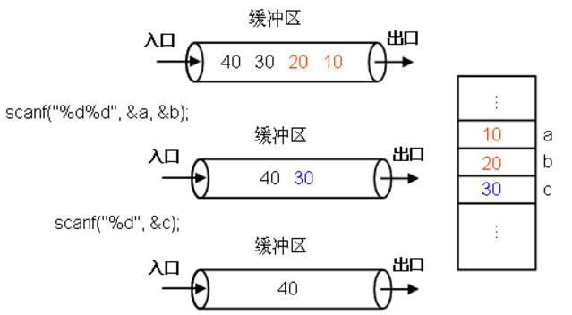

Slide 13
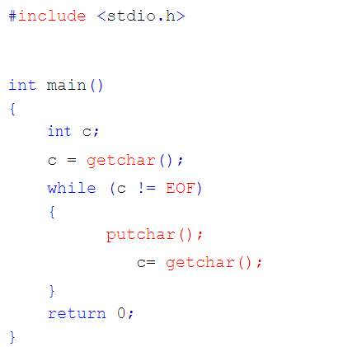

Slide 14
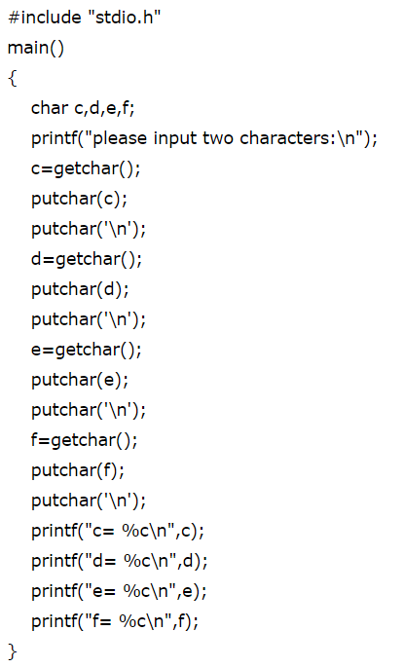
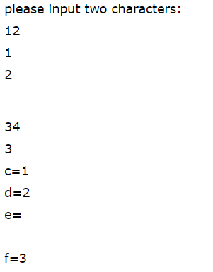
Input:
12
34

Slide 15
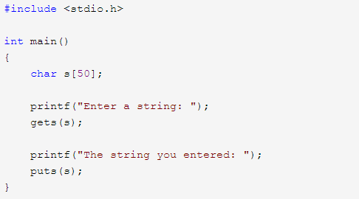

Slide 16
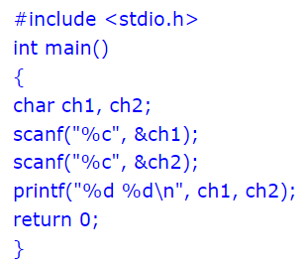
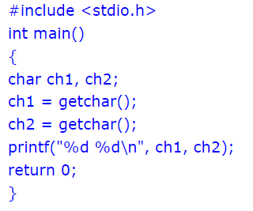

Slide 17
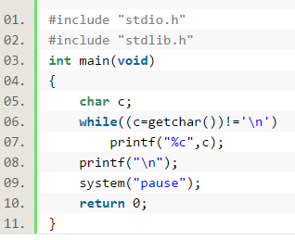

Slide 18
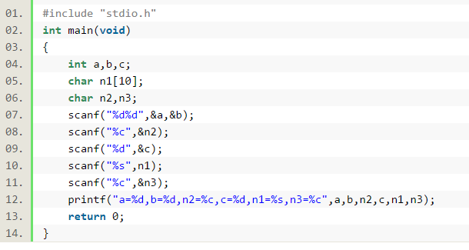
Input:
12
34
45 jfdk
Output:
a=12,b=34,n2=
,c=45,n1=jfdk,n3=

Slide 19
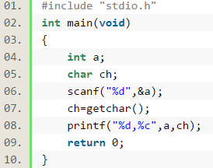
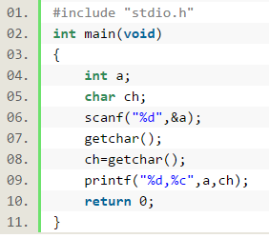
Exercise
Input:
95回车
Input:
95回车
C回车
Output:
?

Slide 20
3.3 File Access
FILE *fp;
FILE *fopen(char *name, char *mode);
fp = fopen(name, mode);
int getc(FILE *fp)；
int putc(int c, FILE *fp)；
int fscanf(FILE *fp, char *format, ...)；
int fprintf(FILE *fp, char *format, ...)；
int fclose(FILE *fp)；

Slide 21
fopen modes
The allowed modes for fopen are as follows:
r - open for reading
w - open for writing (file need not exist)
a - open for appending (file need not exist)
r+ - open for reading and writing, start at beginning
w+ - open for reading and writing (overwrite file)
a+ - open for reading and writing (append if file exists)
Note that it's possible for fopen to fail even if your program is perfectly correct: you might try to open a file specified by the user, and that file might not exist (or it might be write-protected). In those cases, fopen will return 0, the NULL pointer.

Slide 22
Here's a simple example of using fopen:
FILE *fp;
fp=fopen("c:\\test.txt", "r");
Note:This code will open test.txt for reading in text mode. To open a file in a binary mode you must add a b to the end of the mode string; for example, "rb" .
FILE *fp;
fp=fopen("c:\\test.txt", "w");
fprintf(fp, "Testing...\n");

Slide 23
Example: read a data file: f.txt, which include five students grade. Read it and display it on screen.
        301101 张文 91
        301102 陈慧 85
        301103 王卫东 76
        301104 郑伟 69
        301105 郭温涛 55

Slide 24
#include "stdio.h"
int main(void)
{ FILE * fp;
long num; int score;
char stname[20];
if((fp = fopen("f.txt", "r")) == NULL){
printf("File open error!\n");
exit(0);
}
while( !feof(fp) ){
fscanf(fp, "%ld%s%d", &num, stname, &score);
printf("%ld %s %d\n", num, stname, score);
};
if( fclose(fp) ){
printf( "Can not close the file!\n" );
exit(0);
}
}

Slide 25
Writing output to a file
#include <stdio.h>
#include <stdlib.h>
int main(void)
{ FILE *fp;
if( ( fp = fopen("f1.txt", "w") ) == NULL){
printf("File open error!\n");
exit(0);
}
fprintf( fp, "%s", "Hello World! " );
if( fclose( fp ) ){
printf( "Can not close the file!\n" );
exit(0);
}
return 0;
}

Slide 26
Copy a file
#include <stdio.h>
int main(void)
{ FILE *fp1,*fp2;
char c;
if(( fp1 = fopen( "f1.dat", "r" )) == NULL){
printf(" File open error!\n" ); exit(0);
}
if(( fp2 = fopen( "f2.dat", "w" )) == NULL){
printf(" File open error!\n" );
exit(0);
}
while( !feof( fp1 ) ){
c = fgetc( fp1 ); fputc(c, fp2);
}
fclose( fp1 ); fclose( fp2 );
return 0;
}

Slide 27
Thank you!
Q & A

